Slide 1
The Impact of Thin-film
PV on the Cost of Solar
Energy
Bert Haskell-
Director of Product Development

Slide 2
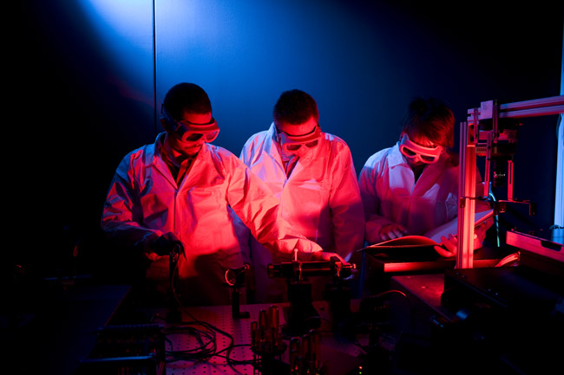
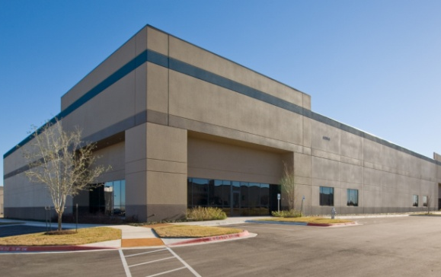
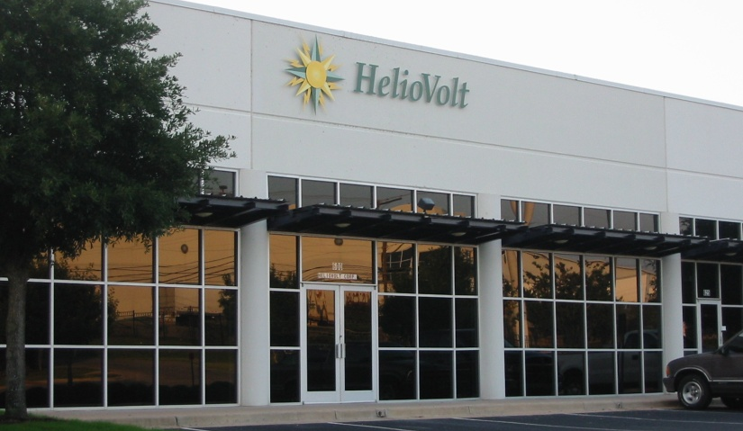
About HelioVolt
Founded: 2001
Location: Austin, TX
Employees: 80+ (160 expected by end of 2008)
Technology: Revolutionary method for manufacturing high-efficiency CIGS PV circuits
  Recently completed $101M Private Equity Financing Round
  Building commercial production facility in Austin
Notes:
Largest ever single venture round of Solar financing
Austin’s desire to be a center of excellence in renwable energy leveraging heritage of IC manufacturing and equipment production.

Slide 3
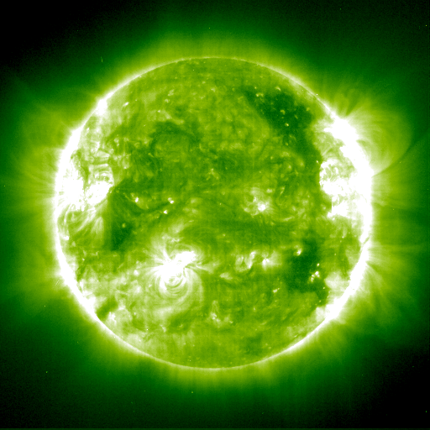
Energy Generation and the Terawatt (TW) Challenge
Humanity uses 12 TW of power today
      1 TW = 1,000 GW (Gigawatts)
World will need 15 TW by 2012
Only 5 known sources of energy are available on a TW scale*
      Fossil fuels: Coal, oil, gas
      Nuclear fuels
      Solar
        Only inherently distributed solution
        No fuel cost
*Prof. Nathan Lewis, http://nsl.caltech.edu/
Notes:
Average Coal fired power plant is 600MW

Slide 4
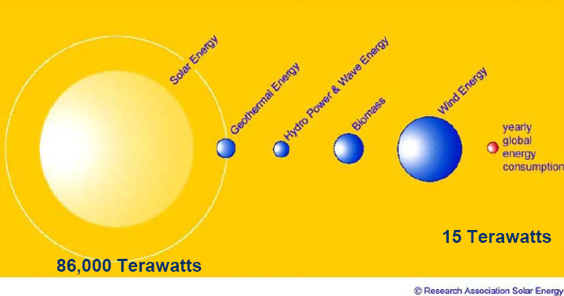
Sun – Our Free Fuel!
The earth receives more energy from the sun in just over one hour
than the world uses in an entire year

Slide 5
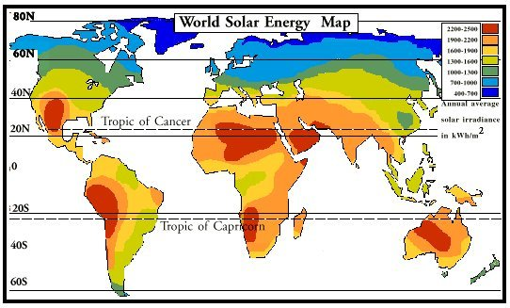
Regional PV-Generation per installed kWp
Notes:
Some areas have more production potential than others, but luckily, not too many people live in those blue regions.
(point out Germany, Spain, the US, and what we can see of Japan, because on the next slide we see ……

Slide 6
Worldwide PV Market by Region
Source: Credit Suisse company compiled data
Notes:
Germany is high because of good incentives and inspite of low insolation

Slide 7
US RPS Goals
Cumulative in MW |  | 2007 | 2010 | 2017 | 2020
 | CA | 380 | 850 | 3,740 | 4,950
 | NY | 115 | 250 | 940 | 1,200
 | NJ | 35 | 130 | 620 | 1,000
U.S. | TX | 15 | 30 | 80 | 100
(per RPS) | IL | 10 | 80 | 350 | 950
 | PA | 5 | 30 | 570 | 850
 | NM | 255 | 370 | 680 | 800
 | AZ | 15 | 50 | 430 | 700
Total U.S. |  | 1,020 | 2,200 | 9,900 | 14,400
Source: Lazzard Freres
Notes:
Renewable portfolio standards
Austin Energy alone already exceeds TX goals with wind farms
New Mexico has a large Thermal solar component

Slide 8
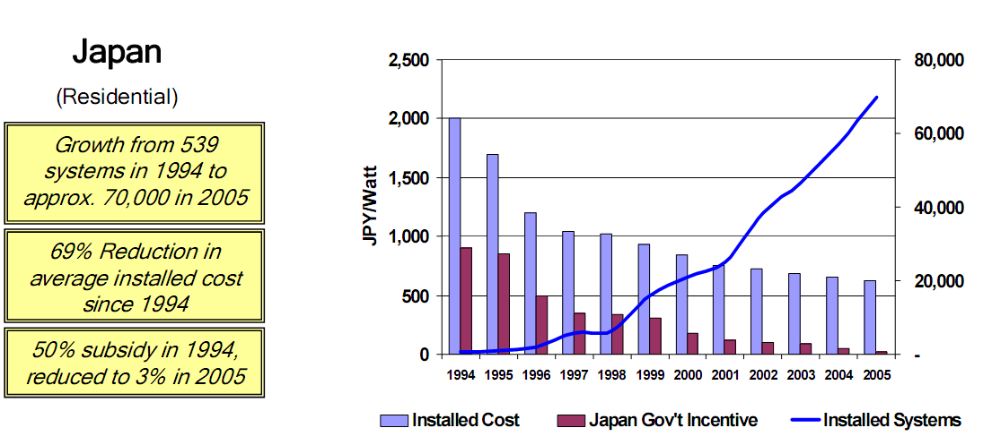
Example of successful long term solar incentives
Source: Christopher O’Brien of Sharp Solar at EESI climate change meeting 2005
Notes:
Introduced 50% subsidy in 1994
Stimulated volume drive cost reduction and gradually reduced subsidy.

Slide 9
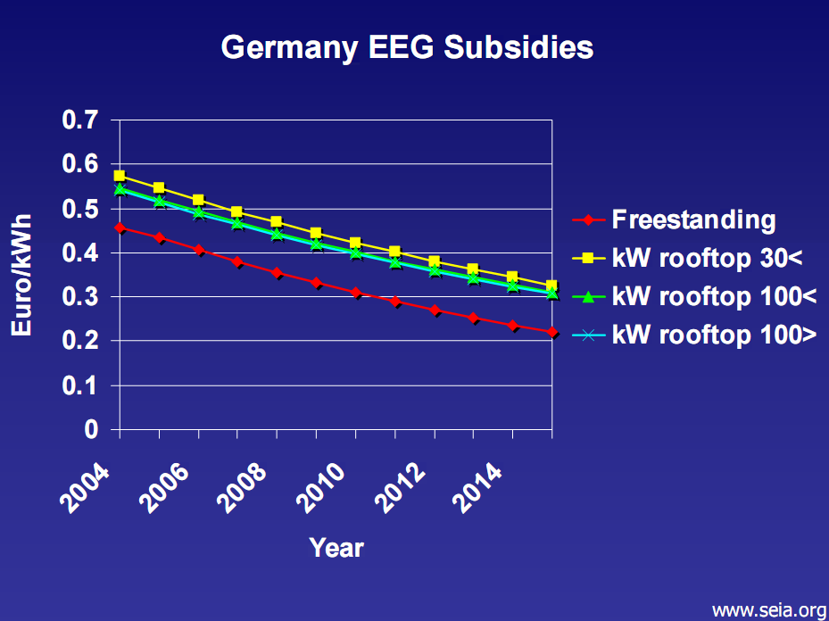
Notes:
Germany is doing the same thing as Japan and subsequently has the most installed PV energy in the world

Slide 10
Projected $/watt trends
Source: Credit Suisse company compiled data
Notes:
White – Installed cost per watt
Yellow - Industry revenue
Blue – Installed GW
It is estimated that $2/W installed is required for grid parity in the US. That number will of course increase as energy costs rise.

Slide 11
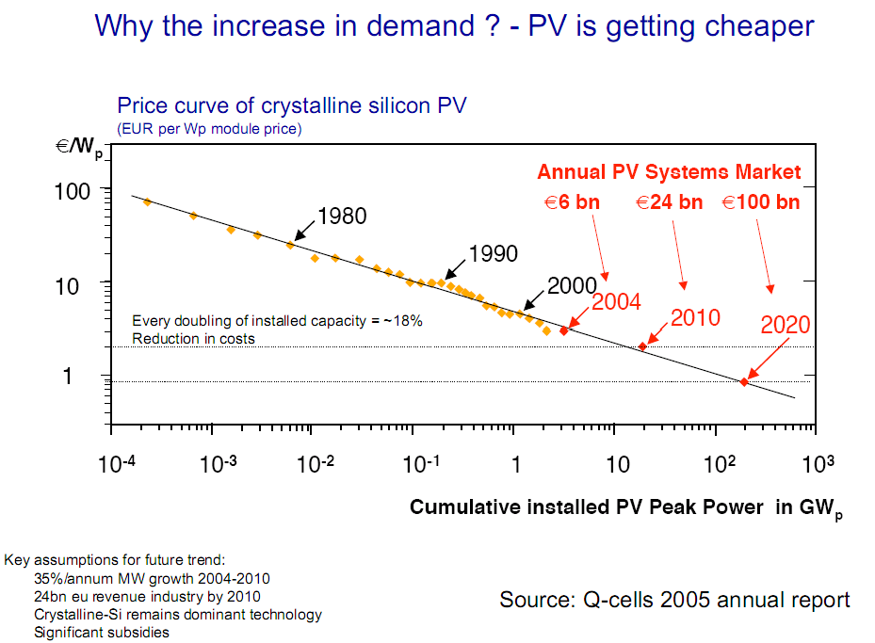
Notes:
Previous slide was installed price of PV in $/watt. This slide shows just the module cost portion of the price.
Learning curve similar to transistors for silicon.

Slide 12
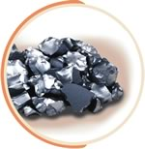
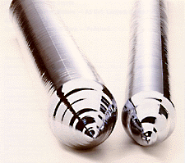

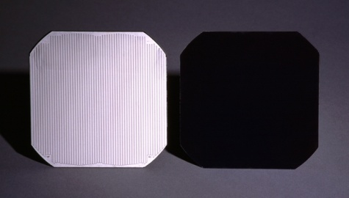
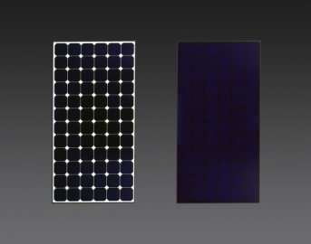
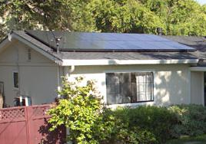
Value Chain Cost Distribution
Polysilicon
Polysilicon
Ingot
Wafer
Solar Cell
Solar Panel
System
2006 US Solar System Cost Allocation by Category
50%
30%
20%
Notes:
The key to cost reduction is the level zed cost of electricity
We can reduce the cost of that 20% by a factor of 100
We can reduce the cost of the 30% by a factor of 5
We can completely eliminate 40% of the remaining 50% by making BIPV real
We can make the cost of solar electricity less than fossil fuel electricity
And thus create a new mass market

Slide 13
Inefficiencies in Today’s Value Chain
15 – 20 + % margins at each step in the value chain
US PV System
Price $/w ~ $7.50
Thin Film Advantage
$
$
$
$
Building Integrated PV
Advantage
$
$

Slide 14
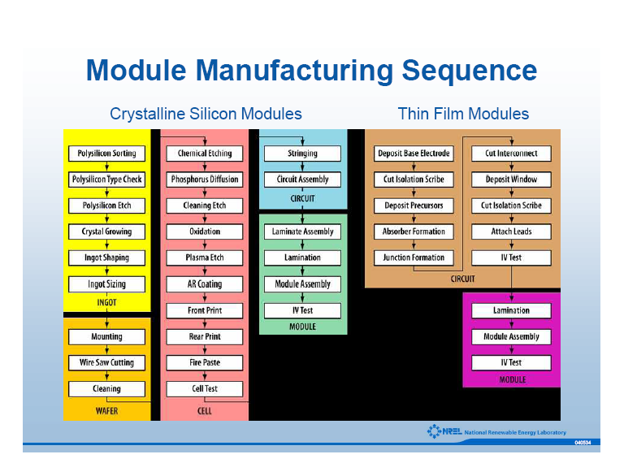

Slide 15
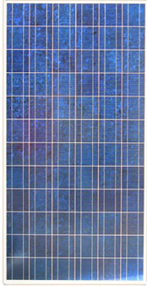

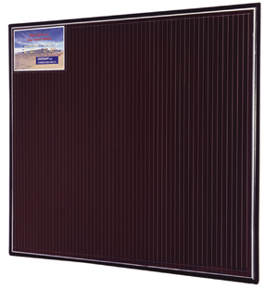
Solar Product Availability
    Crystalline Silicon ~ 18% conversion efficiency
    Multi-crystalline Silicon ~ 14 - 16%
    Amorphous Silicon ~ 6-8%
      Flexible and rigid
    Cadmium Telluride ~ 8-9%
      First Solar capturing significant market share for central power applications
    CIS/CIGS ~11-12%
      New commercial availability entering the market in 2008
90% of
current market
10% of
current market
but fastest
growing segment

Slide 16
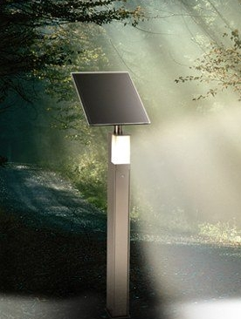
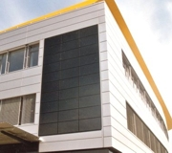

Advantages of thin film PV
    Efficient and high performing materials
      Direct bandgap semiconductors
      Better energy output – kWh/KW
      CIGS record at 19%+ conversion efficiency
    Significantly reduced costs
      Less material usage
        Not affected by silicon supply shortages
      Potential for improving costs throughout value chain
    Better aesthetics
    Roadmap of glass-to-glass and flexible substrate
Notes:
CIGS is a direct band-gap semiconductor (in contrast to crystalline silicon, which is an indirect band-gap semiconductor). This difference is crucial, as it allows CIGS films to generate far more electricity per unit of material. A CIGS film as thin as 1 micron produces a photoelectric effect equal to that of a crystalline silicon wafer 200-300 microns thick. In other words, CIGS cells use less than 1% of the semiconductor material required by crystalline silicon cells, which yields an inherent (and sustainable) cost advantage.
In semiconductor physics, a direct bandgap means that the minimum of the conduction band lies directly above the maximum of the valence band in momentum space. In a direct bandgap semiconductor, electrons at the conduction-band minimum can combine directly with holes at the valence band maximum, while conserving momentum. The energy of the recombination across the bandgap will be emitted in the form of a photon of light. This is radiative recombination, also called spontaneous emission. In indirect bandgap semiconductors such as crystalline silicon, the momentum of the conduction band minimum and valence band maximum are not the same, so a direct transition across the bandgap does not conserve momentum and is forbidden. Recombination occurs with the mediation of a third body, such as a phonon or a crystallographic defect, which allows for conservation of momentum. These recombinations will often release the bandgap energy as phonons, instead of photons, and thus do not emit light. As such, light emission from indirect semiconductors is very inefficient and weak. There are new techniques to improve the light emission by indirect semiconductors. See indirect bandgap for an explanation.

Slide 17
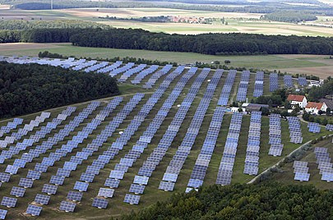
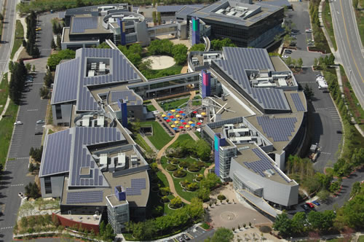

Solar Today
Utility Scale
Commercial Systems
Google HQ -
Solar Project
Solar farm in Amstein, Germany

Slide 18
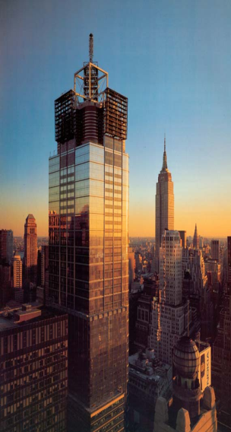
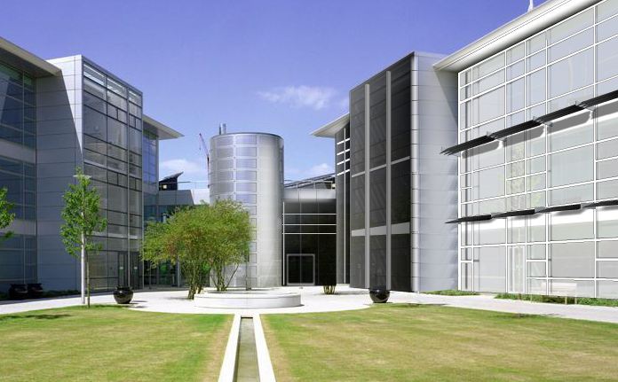
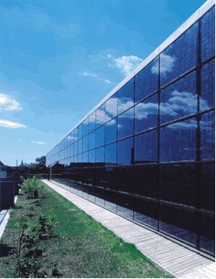
Solar Tomorrow: Building Integrated Photovoltaics
Power Buildings will become multi-$T market
      BIPV is the fastest growing sector of PV
      Building Integration leverages available surface area, installation costs, and proximity to loads
Revolutionary products through efficient, durable thin-film solar cells embedded into traditional building materials
      Current products unsuitable and not cost effective
Notes:
#4 times square
Middle is PV sun shades

Slide 19
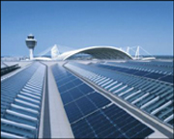
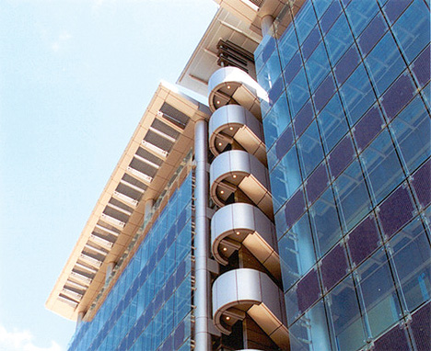
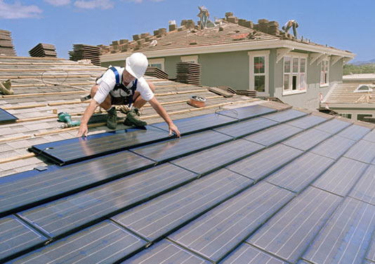
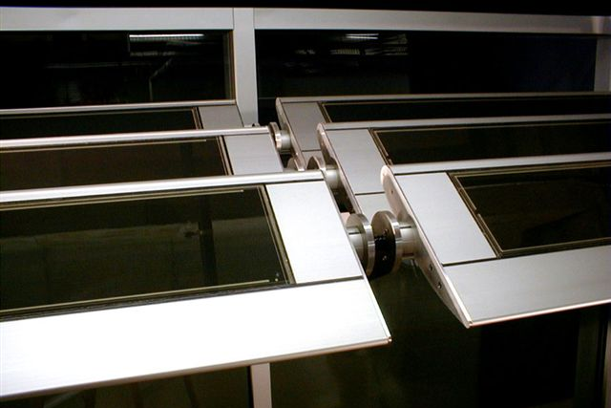
BIPV Applications
    Roofing
      Most common BIPV application today
    Sunshades
      Energy conservation and reduced building operating costs
      Cooling load mitigation and glare control
      Easiest retrofit for PV
    Overhead glazing (canopies, skylights, atriums)
    Curtain wall / Facades
Notes:
Middle from top is HK science bldg.

Slide 20
Example: Correlation between Daily PV Power Production and Energy Consumption of an Office Building in Spain
Source: RWE Energie AG and RSS GmbH
Notes:
Plotted is the typical load profile during the course of the day for an office building in Spain.
The electricity demand in the office building exhibits a pronounced peak between 9 and 16 hours which is significantly higher in summer than in winter. Synchronously in phase to this demand, PV energy is produced by the solar modules.
This is in contrast to the use of wind energy, which can economically best be used in the future in central power stations (multi Gigawatt off-shore) where by the stochastic yield of wind a temporal assignment is not possible. With solar radiation in turn, a clear temporal and seasonal assignment is possible.
Due to this reason, for the assessment of electric energy from different energy sources, the cost calculation for time dependent electricity tariffs will strongly depend on the temporal availability of the energy sources: e.g. conventional energy generation and large hydroelectric stations as compared to new energy generators (wind and PV solar electric).

Slide 21
Broad Challenge for Collaboration
BIPV
Builders
Developers/ Solar Communities
Building Materials Mfgrs
Architects
PV Manufacturers
Government support
Standards Organizations
Trades

Slide 22
Thank you!
Bert Haskell
512-767-6003
bhaskell@heliovolt.com

Slide 23
World’s Highest Performance,
Lowest Cost, & Most Versatile
Solar Power Platform

